Slide 1

DEPARTMENT OF COMPUTER SCIENCE AND ENGINEERING
Music Recommendation Based on Face Emotion Recognition
Name of Students:
FAWWAZ NUMAN : 200071601035
HUMAYOON NIYAZ : 200071601043
Supervisor:
Dr. I.Karthiga
Assistant Professor(CSE)
Domain of Project : Deep Learning
1

Slide 2
DEPARTMENT OF COMPUTER SCIENCE AND ENGINEERING
PROBLEM STATEMENT
Current music recommendation systems cannot consider users' emotional states when suggesting songs, leading to a disconnect between music and emotions.
Moving past conventional musical preferences, the system employs advanced algorithms to decipher emotional nuances, analyzing facial expressions, offering a comprehensive understanding of user’s emotional states with precision.
The problem is to develop a system that can detect real-time emotions from user’s facial expressions and recommend music that aligns with their emotional state, thus enhancing the overall user experience and engagement with music.
The system transforms the music discovery journey by enabling users to establish a profound connection between their emotions and musical preferences. Real-time facial emotion recognition enhances the emotional resonance of music choices, creating a unique and transformative user experience.
Music Recommendation Based on Face Emotion Recognition
2

Slide 3
LITERATURE SURVEY
Title | Author | Year | Limitations | Advantages
Emotion based mood enhancing music recommendation | Aurobind V.Iyer,Viral Pasad, Smita R.Sankher. | 2017 | Limited dataset for emotion training, dependency on accurate facial expression detection, may not consider contextual factors | Enhanced user experience, personalized recommendations aligned with emotional states, potential for improved engagement.
A novel emotion-aware hybrid music recommendation method using deep neural network. | Wang, Shu, et al | 2022 | Challenges in integrating diverse data; potential increased complexity in the recommendation model | Explores multimodal approaches, incorporating both facial expression and other inputs for a more holistic emotion recognition system.
Music Recommendation Based on Face Emotion Recognition
3
3

Slide 4
LITERATURE SURVEY
Title | Author | Year | Limitations | Advantages
Real-time Emotion-based Music Recommendation Using Wearable Devices | Mahadik, Ankita, et al. | 2021 | Relies on users consistently wearing the devices; may have limitations in accurately capturing subtle emotional changes. | Extends emotion recognition to real-time scenarios using wearable devices, offering immediate and personalized music suggestions.
Considering emotions and contextual factors in music recommendation | Assuncao, Willian G., Lara SG Piccolo, and Luciana AM Zaina. | 2017 | Limited empirical validation; more focus on theoretical aspects | Presents an overview of the existing approaches, discusses challenges, and proposes directions for adaptive emotion-based music recommendation systems.
Music Recommendation Based on Face Emotion Recognition
3
4

Slide 5
PROPOSED SYSTEM
The proposed system aims to elevate the interaction between users and their music player by seamlessly integrating facial emotion recognition technology. This innovative approach involves capturing user’s facial expressions in real time, allowing for a dynamic understanding of their emotional states.
The system employs a Convolutional Neural Network (CNN) to predict emotions from the gathered facial data. This advanced machine learning technique ensures accurate recognition, enhancing the system's ability to interpret the subtleties of user’s emotional responses.
Personalized music recommendations form the core of the system's functionality, driven by the real-time detection of user’s emotional states with the help of API. The integration of emotion-based algorithms ensures that the music suggestions align with their immediate emotional contexts.
The platform is designed to provide users with an immersive and emotionally resonant music experience. By dynamically tailoring recommendations based on real-time facial expressions, the system aims to create a more engaging and personalized musical journey for each user.
Leveraging state-of-the-art emotion recognition algorithms and a user-centric design approach, the envisioned system not only prioritizes accuracy in emotion prediction but also focuses on delivering a seamless and intuitive user experience, ultimately enhancing the overall enjoyment of the music.
Music Recommendation Based on Face Emotion Recognition
7
5

Slide 6
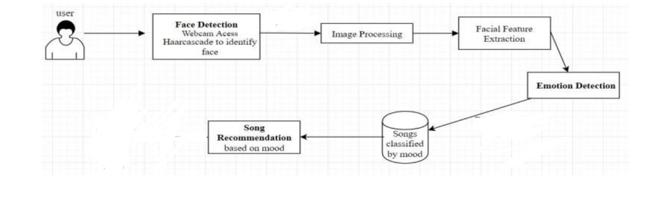
ARCHITECTURE
Music Recommendation Based on Face Emotion Recognition
10
6

Slide 7
Algorithm
CNN(-Convolutional Neural Network):
A Convolutional Neural Network (CNN) is a type of artificial neural network designed specifically for processing and analyzing visual data, such as images. In the context of the provided code:
Convolutional Layers (Conv2D): These layers perform convolution operations on the input images. They use filters or kernels to slide across the input image, extracting features by detecting patterns of pixel values.
Activation Function (ReLU): Rectified Linear Unit (ReLU) is commonly used as the activation function in CNNs. It introduces non-linearity to the model, allowing it to learn complex patterns and relationships in the data.
Pooling Layers (MaxPooling2D): These layers downsample the spatial dimensions of the input feature maps, reducing their size and computational complexity. Max pooling, in particular, retains the most significant information from the input.
Music Recommendation Based on Face Emotion Recognition
10
7

Slide 8
Algorithm
CNN(-Convolutional Neural Network):
Dropout Layers (Dropout): Dropout is a regularization technique used to prevent overfitting. It randomly drops a fraction of the neurons during training, forcing the network to rely on different pathways and improving generalization.
Flatten Layer (Flatten): This layer flattens the 2D feature maps into a 1D vector, preparing the data for input to fully connected layers.
Fully Connected Layers (Dense): These layers connect every neuron from one layer to every neuron in the next layer. They are responsible for combining high-level features and making predictions.
Softmax Activation (Softmax): Applied in the output layer, the softmax activation function normalizes the output values into a probability distribution, allowing the model to predict the class probabilities for multiclass classification problems.
Music Recommendation Based on Face Emotion Recognition
10
8

Slide 9
Algorithm
CNN(-Convolutional Neural Network):
Loss Function (Categorical Cross-entropy): This is a measure of how well the predicted probabilities match the true distribution of classes. It is minimized during training to improve the model's accuracy.
Optimizer (Adam): Adam is an optimization algorithm used to update the weights of the network during training, aiming to minimize the loss function efficiently.
Music Recommendation Based on Face Emotion Recognition
10
9

Slide 10
MODULE DESCRIPTION
Module 1: Data Collection and Labeling
Description: This module focuses on gathering a dataset of facial expressions, meticulously labeled with corresponding emotions. The dataset is sourced from various facial expression databases and user interactions, forming the foundation for training the emotion recognition model.
Key Tasks:
- Collecting facial expression data from diverse sources.
- Labeling the data with accurate emotion annotations.
- Curating the dataset to ensure quality and diversity.
Module 2: Facial Emotion Recognition Model Training
Description: This module involves training an emotion recognition model using Convolutional Neural Networks (CNNs) to accurately identify a range of emotions from facial expressions.
Key Tasks:
- Preprocessing the facial expression dataset for model training.
- Designing and implementing CNN architectures for emotion recognition.
- Training the model using labeled facial expression data.
Music Recommendation Based on Face Emotion Recognition
8
10

Slide 11
Module 3: Integration with Music Preferences using API
Description: This module integrates the emotion recognition model with user-specific music preferences, creating a labeled dataset that associates facial emotions with preferred music genres, artists, or specific tracks.
Key Tasks:
- Accessing and integrating APIs for music preference data.
- Creating a labeled dataset linking facial emotions with music preferences.
- Establishing connections between facial expressions and music preferences.
Module 4: Fine-tuning and Optimization
Description: This module focuses on fine-tuning the integrated model using transfer learning to adapt it to individual users. Model performance is optimized based on metrics such as accuracy, precision, and recall.
Key Tasks:
- Fine-tuning the integrated model using transfer learning techniques.
- Optimizing model performance through iterative experimentation.
- Evaluating model performance using appropriate metrics.
Music Recommendation Based on Face Emotion Recognition
9
11

Slide 12
Module 5: User Interaction and Facial Emotion Capture
Description: This module involves capturing real-time facial expressions using computer vision techniques during the inference phase.
Key Tasks:
- Implementing real-time facial expression capture using computer vision.
- Processing and analyzing facial expressions for emotion recognition.
- Providing inputs for music recommendation based on detected emotional states.
Module 6: Music Recommendation
Description: This module dynamically recommends music based on detected emotional states and user preferences, utilizing various recommendation techniques.
Key Tasks:
- Developing algorithms for music recommendation based on facial emotions and user preferences.
- Implementing personalized music recommendations in real time.
- Evaluating the effectiveness of music recommendations through user feedback and metrics.
12

Slide 13
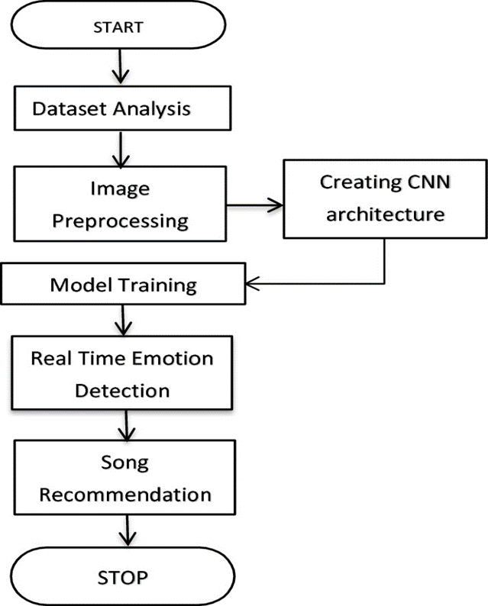
DATA FLOW
Fig. Data Flow Diagram
Music Recommendation Based on Face Emotion Recognition
12
13

Slide 14
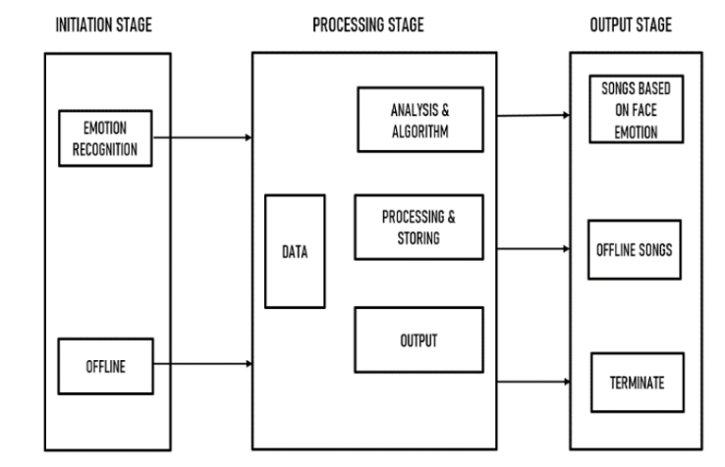
IMPLEMENTATION
14

Slide 15
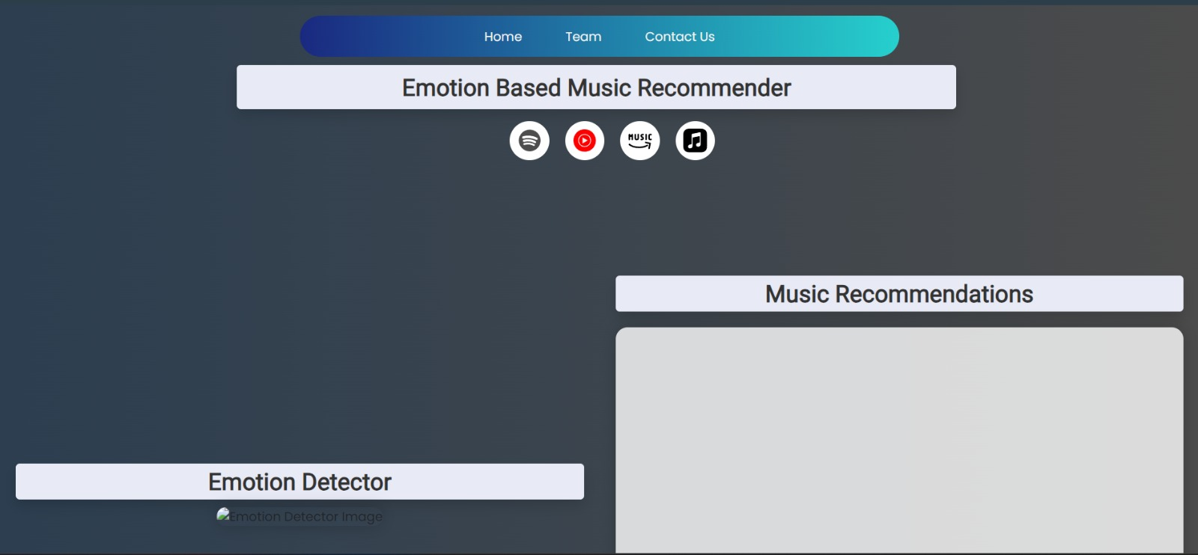
User-Interface
15

Slide 16
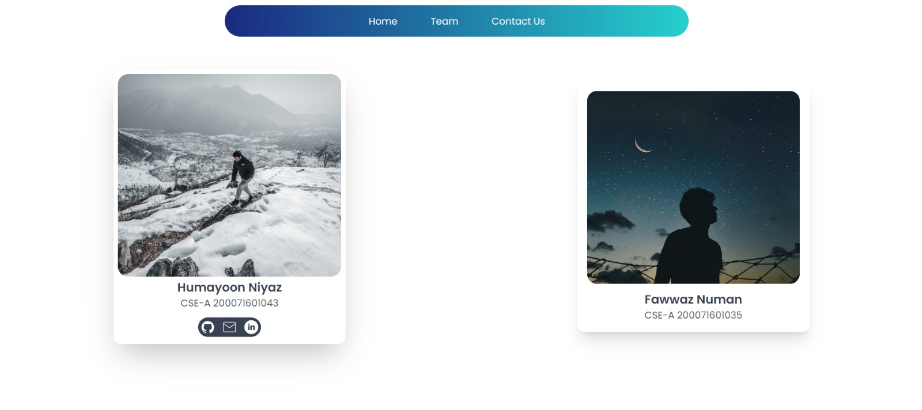
16

Slide 17
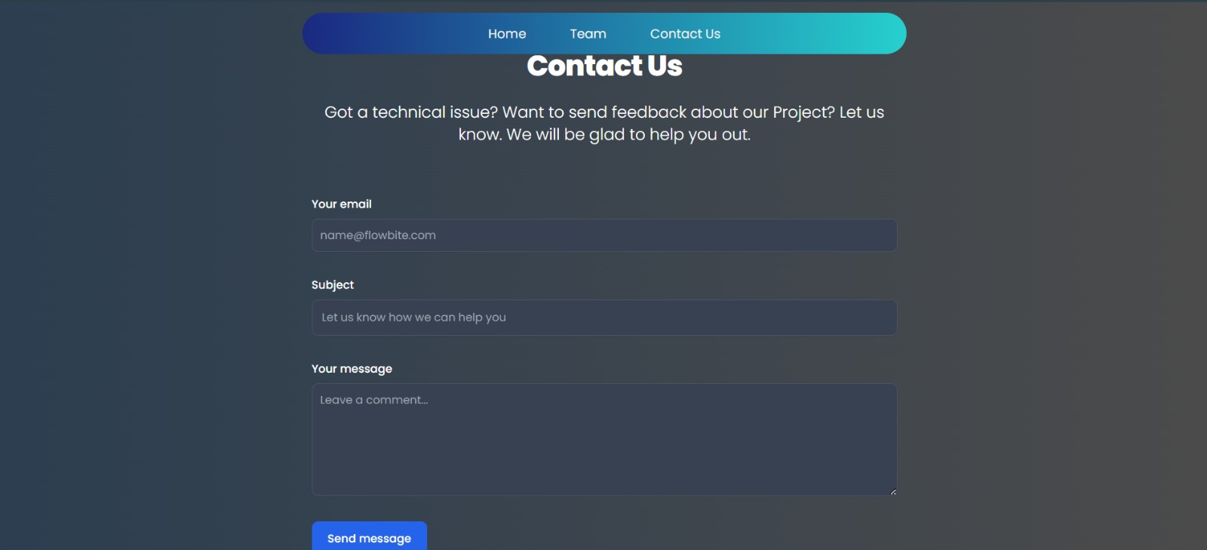
17

Slide 18
Facial Emotion Detection Accuracy: Our facial emotion detection accuracy, at 80%, ensures precise music recommendations to users' emotional states. Music Recommendation Functionality: Emotion-based detection effectively drives Music recommendations. User Interface and Experience: The interface is intuitive, clean, and user-friendly, enhancing the overall experience. Integration with Music Platforms: The interface is intuitive, clean, and user-friendly, enhancing the overall great music experience.
RESULT AND ANALYSIS
18

Slide 19
RESULT AND ANALYSIS
User Feedback and Satisfaction: Gathered feedback from users who have interacted with the music recommendation system. Conducted surveys or interviews to understand their satisfaction levels and any suggestions for improvement.
Effectiveness of Recommendations: Analyzed the effectiveness of music recommendations based on detected facial emotions. Determined whether users find the recommended music suitable for their current emotional state.
Usage Patterns and Behavior: Analyzed usage patterns to understand how users interact with the recommendation system based on their facial expressions.
Impact on User Mood: Evaluated whether the recommended music has a measurable impact on the mood or emotional state of users.
19

Slide 20
CONCLUSION
The development and deployment of the Music Recommendation System utilizing Facial Emotion Detection have successfully addressed the demand for personalized and emotionally resonant music experiences. Employing a combination of facial recognition technology, emotion detection algorithms, and music recommendation using API’s, we've created a novel platform that tailors music suggestions based on the user's emotional state. This project showcases the efficacy of integrating diverse technologies to create a seamless and engaging user experience. Users benefit from a dynamic interface that responds to their emotional cues, providing music recommendations that align with their current mood. The system's ability to analyze facial expressions in real time and adjust music recommendations accordingly marks a significant advancement in personalized music recommendation systems.
20

Slide 21
FUTURE ENHANCEMENTS
Enhance the Music Recommendation System by refining emotion detection algorithms for better accuracy in interpreting subtle facial expressions. Integrate machine learning to adapt to individual preferences over time. Expand the music database to include diverse genres and artists. Incorporate user feedback for continuous algorithm refinement. Explore social sharing features for enhanced user engagement and platform growth.
21

Slide 22
REFERENCES
Aurobind V.Iyer,Viral Pasad, Smita R.Sankher on Emotion based mood enhancing music recommendation, International Journal of Engineering Research & Technology (IJERT), ISSN-2278-0181, Volume 6, Issue 15, 2017
Wang, Shu, A novel emotion-aware hybrid music recommendation method using deep neural network, February 17, 2020.
Mahadik, Ankita. Real-time Emotion-based Music Recommendation Using Wearable Devices 2021
Assuncao, Willian G., Lara SG Piccolo, and Luciana AM Zaina. Considering emotions and contextual factors in music recommendation A Surve 2017
Music Recommendation Based on Face Emotion Recognition
16
22

Slide 23

Music Recommendation Based on Face Emotion Recognition
17
23

